Slide 1
Tribal land ownership
From an Oglala tribal member perpective

Slide 2
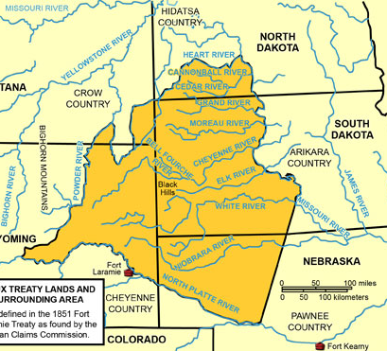
What does successful conservation look like to me as a tribal member and land owner?
To live in our territory, to steward and protect, to remain connected.
One cannot own their grandmother.

Slide 3
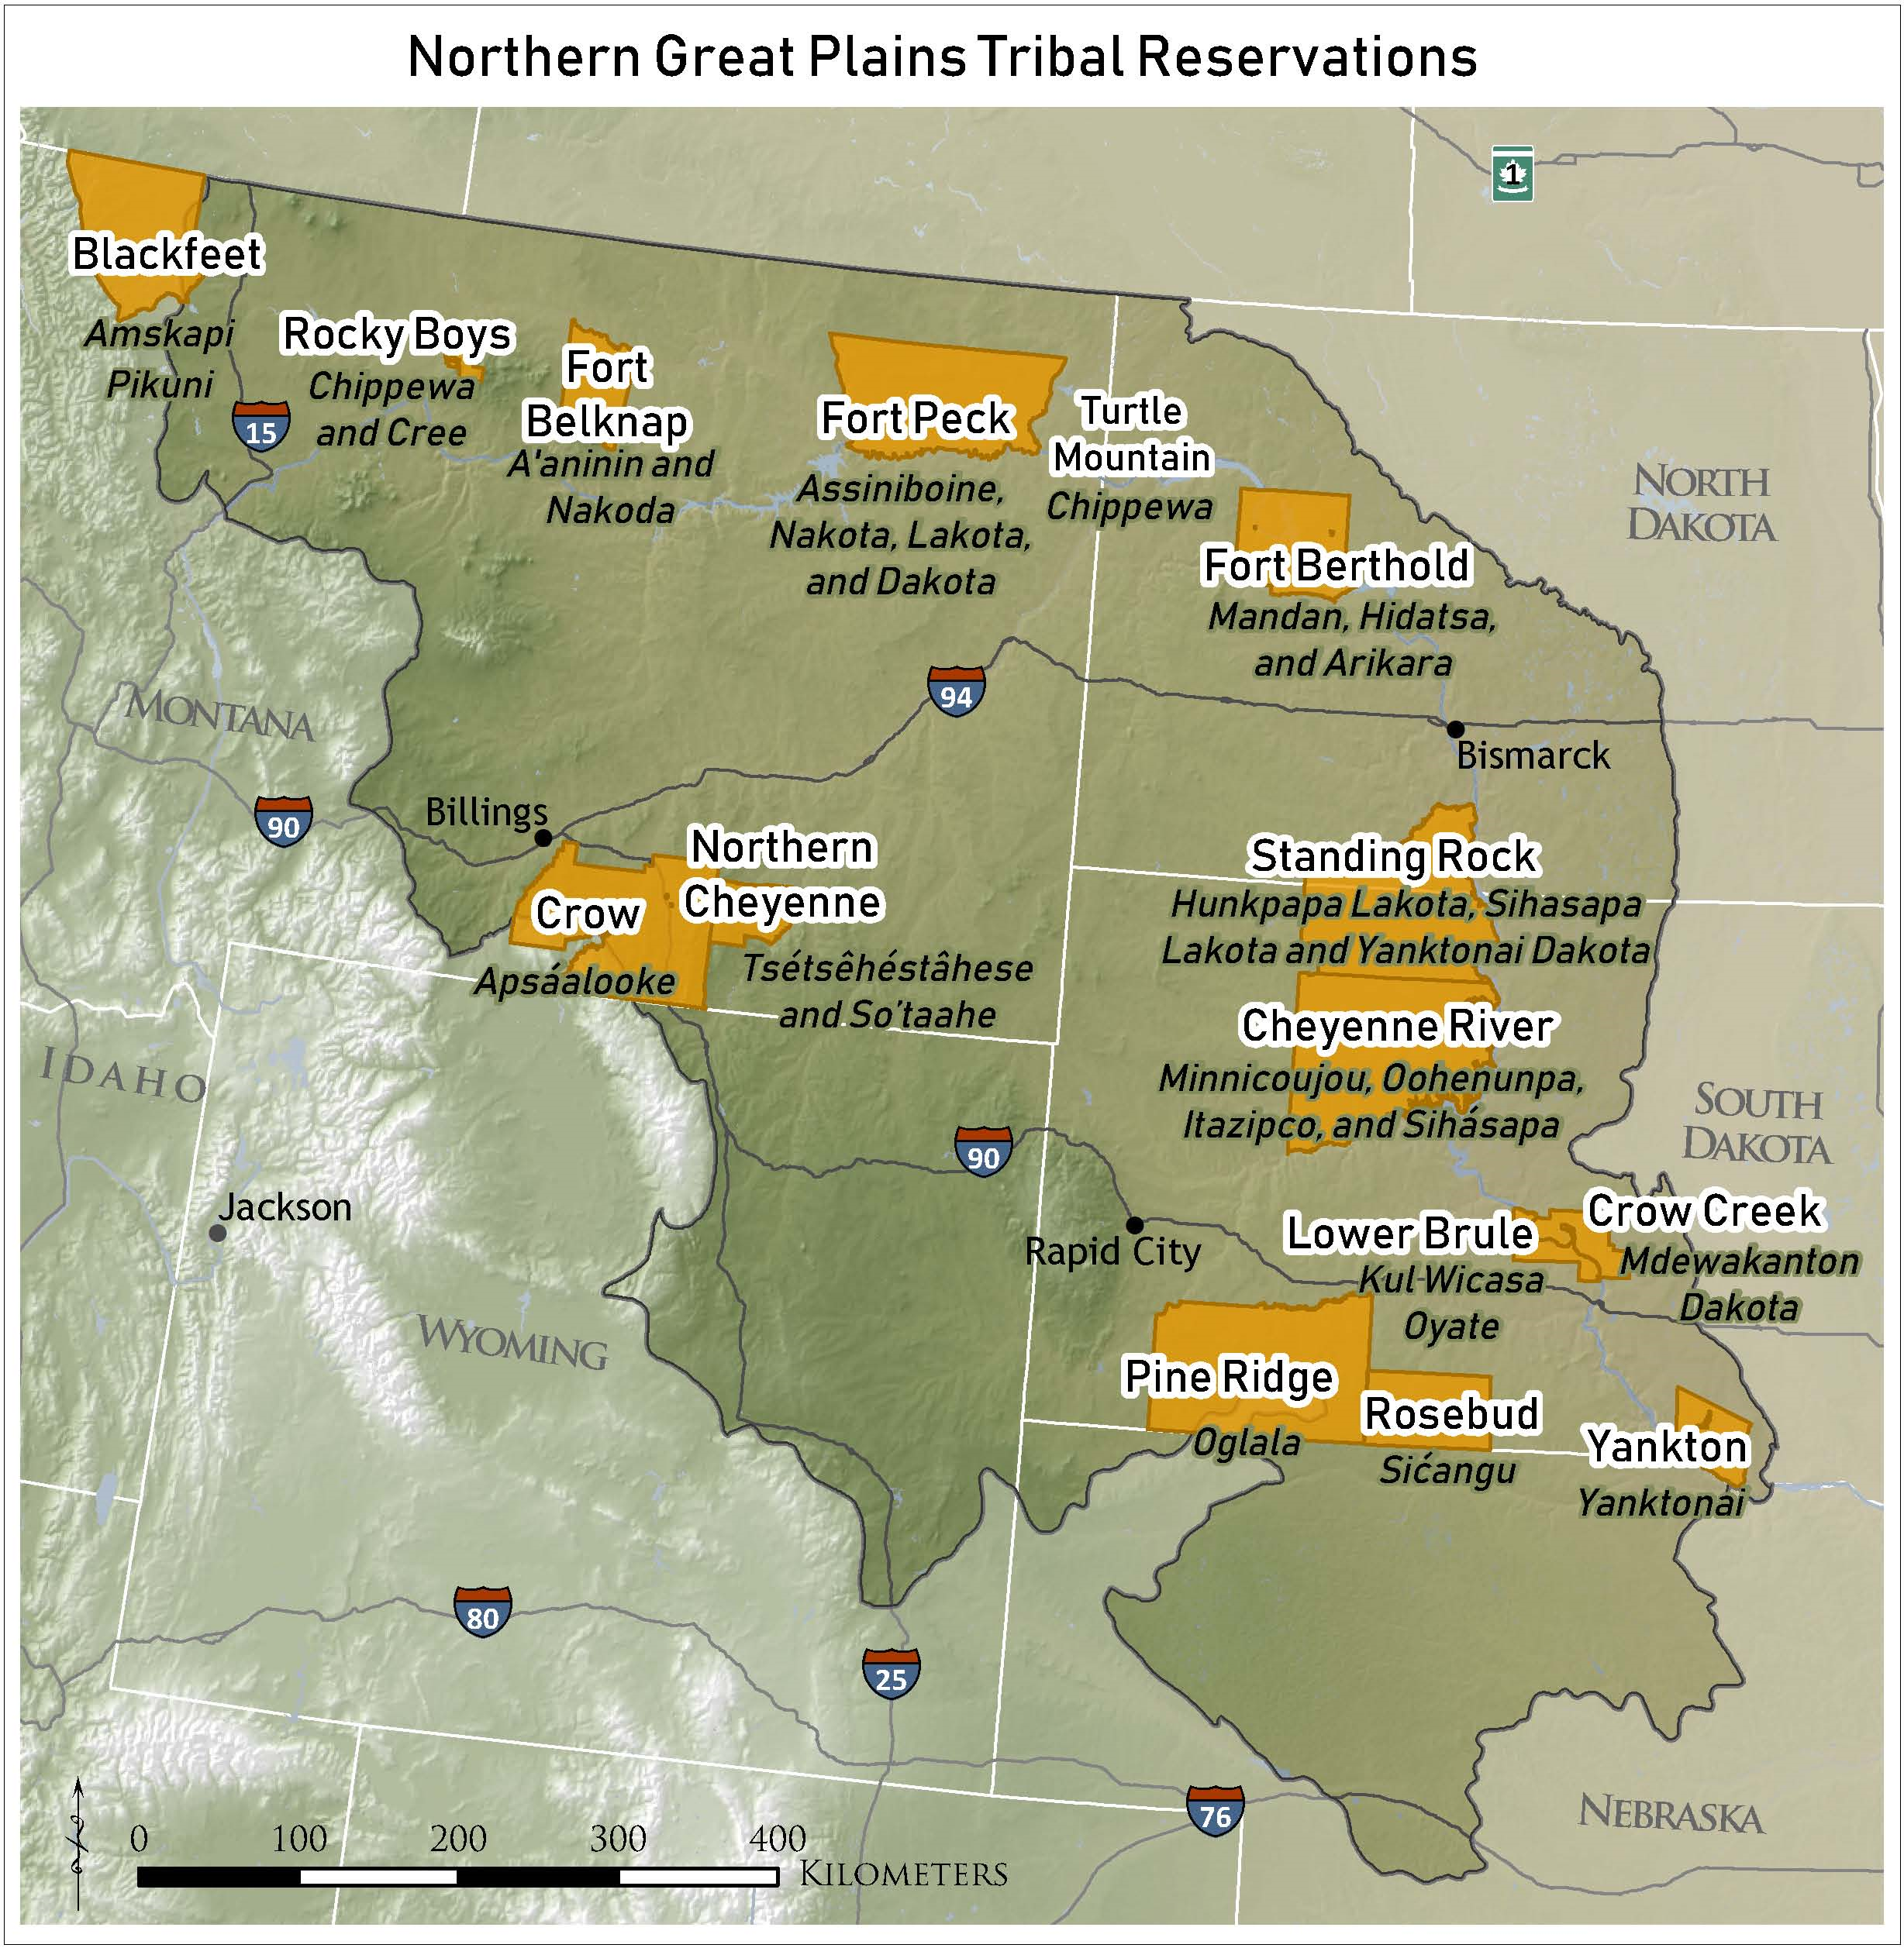
Dawes Allotment Act of 1887 & Homestead Act
To each head of a family, one-quarter of a section; To each single person over eighteen years of age, one-eighth of a section ; To each orphan child under eighteen years of age, one-eighth of a section; and To each other single person under eighteen years now living, or who may be born prior to the date of the order of the President directing an allotment of the lands embraced in any reservation, one-sixteenth of a section…”

Slide 4
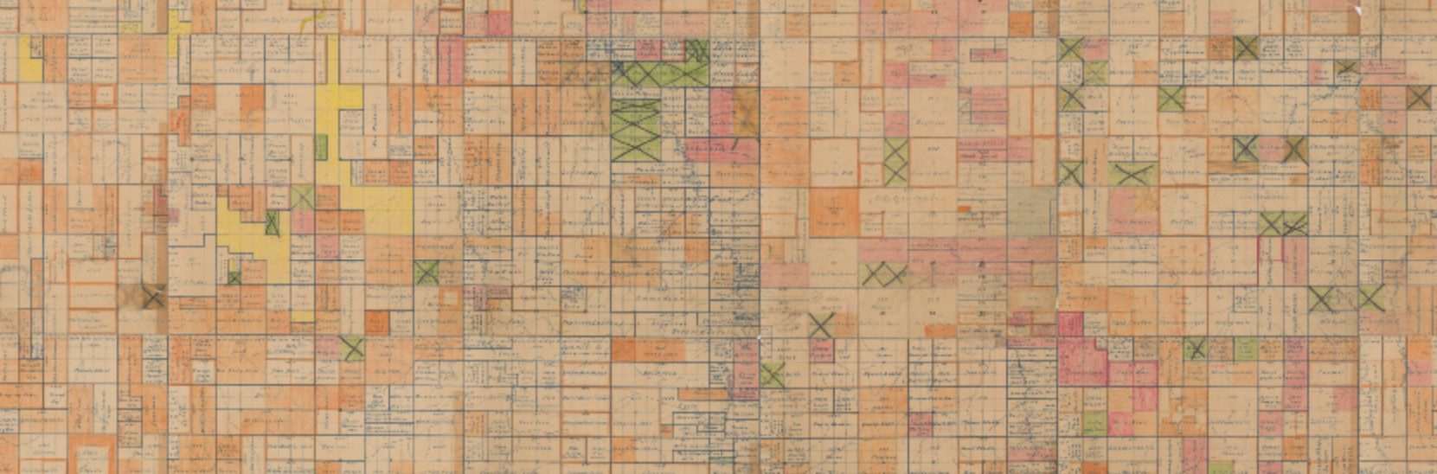
Agencies created and Bureau of Indian Affairs Policies established
Fractionation
Range Units-economic status
Loss of individual control
Lack of conservation

Slide 5
Conservation to me looks like taking communally owned land and creating conservation area.
Also finding ways of competing for land, pay lease and create conservation.

Slide 6
Greatest Concerns and what works
Concerns
Successes
Elected officials not knowledgeable regarding grassland conservation and our medicinal plants
Tribes not included in the discussion and resources, including knowledge of current systems not shared with tribes
Having to compete amongst ourselves for land
Tribal programs acquiring leases
Partnerships and collaborations
Individual tribal members pushing local legislation
Reclaiming life ways and putting into practice

